Slide 1
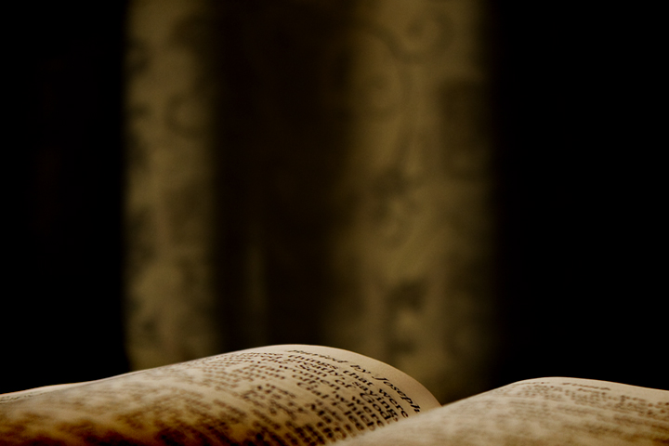
The Power of the Resurrection
Easter Sunday
Acts Community Church

Slide 2
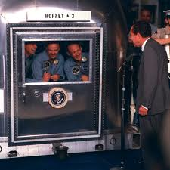
Apollo 11 Astronauts & Nixon

Slide 3
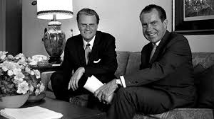
Graham reminded him of something more important – Easter

Slide 4
The Power of the Resurrection
The resurrection of Christ declares who Jesus is … and confirms all that he makes known of our world and our lives.

Slide 5
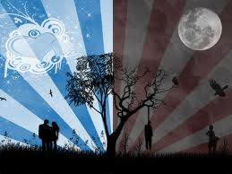

Slide 6
Luke 24:13-19 (NIV)
¹³ Now that same day two of them were going to a village called Emmaus, about seven miles from Jerusalem. ¹⁴ They were talking with each other about everything that had happened.

Slide 7
15] As they talked and discussed these things with each other, Jesus himself came up and walked along with them; [16] but they were kept from recognizing him.

Slide 8
They needed a change in the way they recognized the work of God around them
In order to get the work of Christ within them

Slide 9
[17] He asked them, "What are you discussing together as you walk along?"
They stood still, their faces downcast.
[18] One of them, named Cleopas, asked him, "Are you only a visitor to Jerusalem and do not know the things that have happened there in these days?"
[19] "What things?" he asked.

Slide 10
The first step Christ takes to transform their reality
He prompts them to share their longings
He gets them to share t - their desires
– their shattered expectations

Slide 11
"About Jesus of Nazareth," they replied.
"He was a prophet, powerful in word and deed before God and all the people.
[20] The chief priests and our rulers handed him over to be sentenced to death, and they crucified him;
21] but we had hoped that he was the one who was going to redeem Israel. And what is more, it is the third day since all this took place.

Slide 12
22] In addition, some of our women amazed us. They went to the tomb early this morning
[23] but didn’t find his body. They came and told us that they had seen a vision of angels, who said he was alive.
[24] Then some of our companions went to the tomb and found it just as the women had said, but him they did not see."

Slide 13
[25] He said to them, "How foolish you are, and how slow of heart to believe all that the prophets have spoken!
[26] Did not the Christ have to suffer these things and then enter his glory?"
[27] And beginning with Moses and all the Prophets, he explained to them what was said in all the Scriptures concerning himself.

Slide 14
Jesus shows them the condition of their heart
We interpret reality through the condition that our heart is in at the time

Slide 15
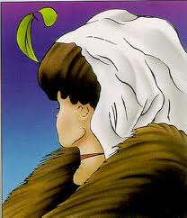

Slide 16
[28] As they approached the village to which they were going, Jesus acted as if he were going farther.
[29] But they urged him strongly, "Stay with us, for it is nearly evening; the day is almost over." So he went in to stay with them.

Slide 17
[30] When he was at the table with them, he took bread, gave thanks, broke it and began to give it to them.
[31] Then their eyes were opened and they recognized him, and he disappeared from their sight.
[32] They asked each other, "Were not our hearts burning within us while he talked with us on the road and opened the Scriptures to us?"

Slide 18
Jesus opened their eyes to the truth
Their hearts were burning with the reality that Jesus made known
Their road of despair turned into a highway of hope

Slide 19
What is this transforming reality?
1. God is alive and He cares for you
He is there for you
If you call upon Him

Slide 20
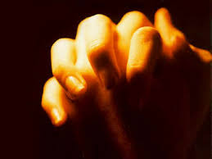
Bring your need to Him in prayer

Slide 21
Forgiveness and Acceptance
“You were dead because of your sins and because your sinful nature was not yet cut away. Then God made you alive with Christ. He forgave all our sins. He canceled the record that contained the charges against us. He took it and destroyed it by nailing it to Christ’s cross.” Col. 2:13-14 [NLT]

Slide 22
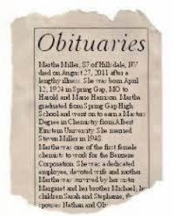

Slide 23
What is this transforming reality?
2. The power of evil in our world has been defeated.

Slide 24
What is this transforming reality?
3. The power of death has been defeated.

Slide 25
How do we receive the reality of the risen Christ?
Philip. 3:10 I want to know Christ and the power of his resurrection…

Slide 26
[33] They got up and returned at once to Jerusalem. There they found the Eleven and those with them, assembled together
[34] and saying, "It is true! The Lord has risen and has appeared to Simon."
[35] Then the two told what had happened on the way, and how Jesus was recognized by them when he broke the bread.

Slide 27
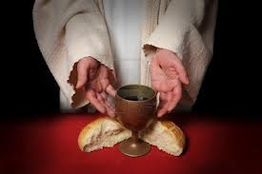
Communion

